Slide 1

Empowering Students with Real-World Exposure
KLiC Internship by MKCL

Slide 2
About MKCL
Established in 2001 by the Government of Maharashtra
Vision: Create a knowledge-led society by bridging the digital divide
Delivered high-quality, affordable digital education across Maharashtra
Empowered over 1.3 crore learners

Slide 3
Authorized Learning Center
MKCL has 5000+ centers across Maharashtra
ALCs are MKCL’s implementation partners
Deliver training, mentorship, and academic support
With ALCs, MKCL has educated crores of learners
Bridge between students, colleges, and MKCL offerings

Slide 4
About KLiC Brand
Career-oriented, skill-based courses by MKCL
Aligned with National Skill Qualification Framework (NSQF)
Courses in IT, design, finance, digital marketing, etc.
Recognized by industry

Slide 5
Key Features of KLiC Internship
Real-time, domain-specific internships
Work-Based Learning approach
Focus on skill application
Duration:
2 - 3 months
Structured training and project work
MKCL certification on completion

Slide 6
Benefits to Students
Hands-on experience with live projects
Enhances resumes
Builds soft skills
Mentorship by professionals
Increases job-readiness
Certified internship

Slide 7
How is this Different?
KLiC Internship
Other Internships:
Structured & monitored
Domain-aligned
Clear learning outcomes
Project-based work
MKCL certification
  Often unstructured
  Generic tasks
  Limited objectives
  Errand-based
  No certification

Slide 8
Meaningful Job Roles & Internships
Digital Marketing Intern
Graphic Designer
Office Automation Executive
Tally Operator
Web Designer
Aligned with student’s course

Slide 9
Monitoring and Tracking
Progress tracked via MKCL LMS
Weekly reports and feedback
ALC support
Evaluation on attendance, projects & behavior

Slide 10

Monitoring & Tracking
Sequential Learning
Weekly Work Report

Slide 11
Course Structure
Basic English
Soft Skills
Job Readiness Skills
Weekly Report

Slide 12

Basic English

Slide 13

Soft Skills

Slide 14
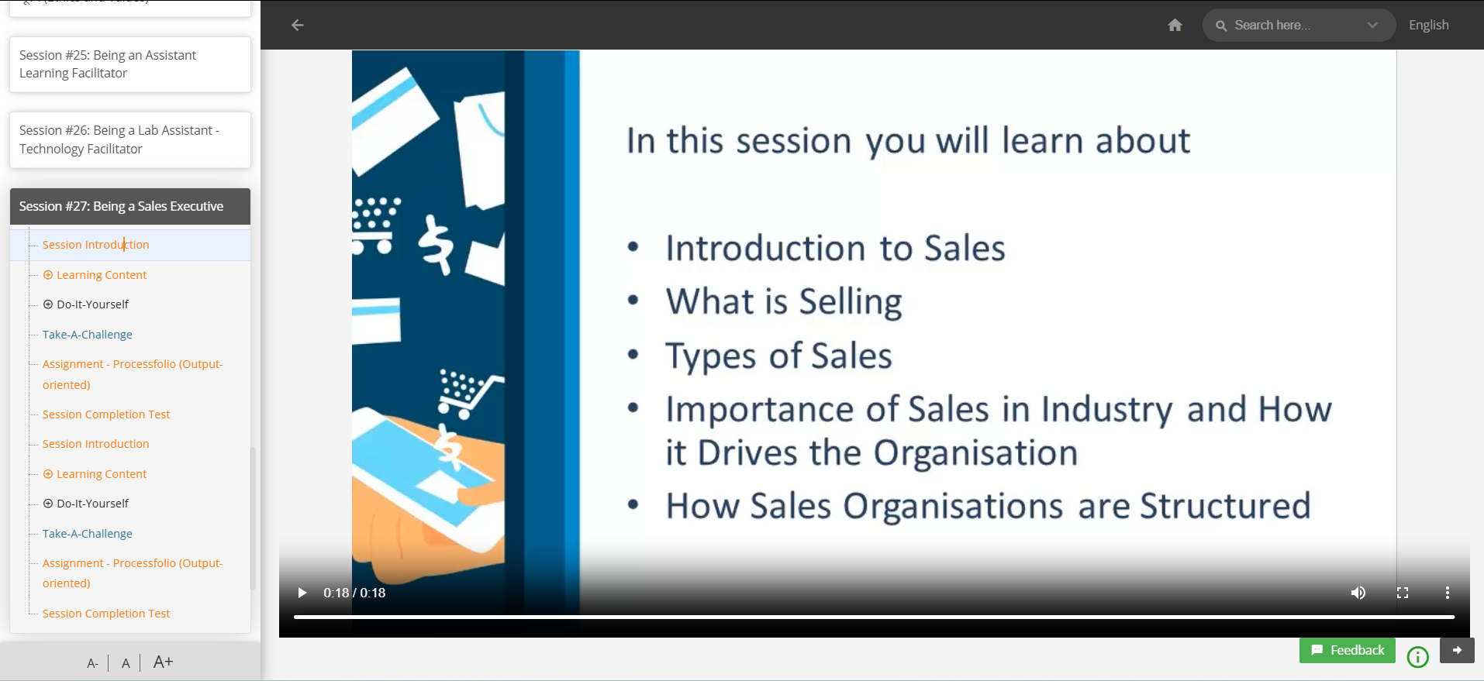
Job Readiness Skills

Slide 15
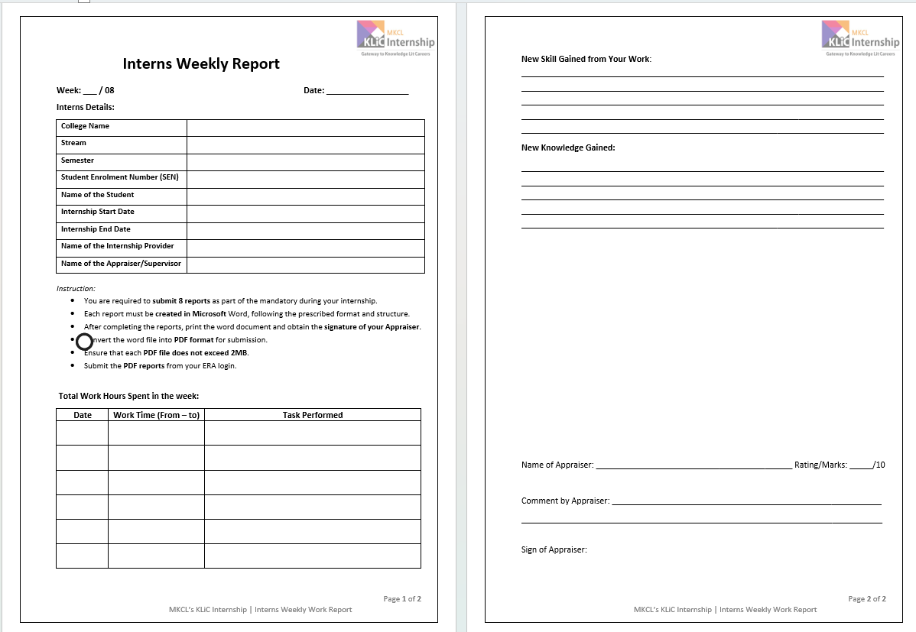
Notes:
Auto Evaluation By AI and Marks entries, Constructive Feedback

Slide 16
Interns Enrolment Process
College shall refer students to ALC
Student shall Visit respective ALC
Information about KLiC Internship
Student Registration for KLiC Internship
ALC shall update student’s internship record in System
ALC shall issue an Internship Award Letter
Student can submit this Internship Award Letter to the College.
Learner Code allotment to Intern & data transfer to the Learning Framework"
ALC shall communicate the details to the Learner

Slide 17
Roles & Responsibilities- ALC
Offer
Offer internships to max 5 interns for at least 2 month
Guide
Guide interns on Job Role & Code of Conduct
Facilitate
Facilitate learning, track progress, and evaluate performance of interns
Maintain
Maintain performance records & issue Experience/ Completion Letters

Slide 18
Roles & Responsibilities- Interns
Complete daily learning & assigned tasks
Submit weekly reports & final internship report
Adhere to ALC’s tracking & evaluation process

Slide 19

Join Hands to Transform Student Futures
Partner with ALCs to provide real-world exposure
Support students' transition from classroom to career

